Slide 1
PoLLaan Kailaan (KailoKesur) – Jhaad hovDengo
Fruits and Vegetables – Growing plants
By Kamini Parasurama

Slide 2
kELO
Banana

Slide 3
sole KeLo
tovdo
keLo
Peel/skin
Banana

Slide 4
Kacce keLo
RAW Banana

Slide 5
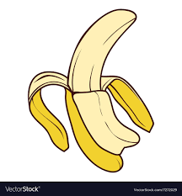
KELO
tu kaay saartE/saariy0? keLo saartE/saariyo ( I see banana)
keLo kollEd/KOT sEtE? ( Where is banana?)
KeLo, poLLaan teTTaam (Fruits Plate) sE. (Banana is on the fruit plate)
keLo, PoLLaan teTTaam kOn thoveyO? ( Who put banana on the fruit plate)
keLo, polLLaan teTTaam Bo thoveyo ( Bo put banana on the fruit plate)
tu kago keLo saartE? ( Why do you look at the banana)
mii keLo khaato kucci saartE? ( I want to eat banana. That is why looking)
togo atto bhookh kerariyokyae? ( Are you hungry now?)
mogo atto bhookh kerariyo ( I am hungry now)
keLo piKki sEkyae? ( Is the banana ripe?)
KeLo pikki sE ( Yes, banana is ripe)
tu onTe keLo khaLLi, soli khaa ( You take one banana, peel and eat)
Mii onTey keLo khaLLi soli khavus ( I will take one banana, peel and eat)
keLo gulle sEyae? ( Is the banana sweet?)
haai keLo gulle sey ( Yes, the banana is sweet)
asko keLo khaiti/khaithiyo kyae? (Did you eat the full banana?)
Haai asKo keLo khaiti/khaitiyo ( Yes, I ate the full banana)
Togo pOD bhoreskyae? ( Is your stomach full now?)
Mogo POD bhojjyo ( My stomach is full)

Slide 6
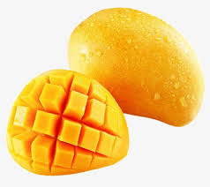
kaccambaa poLLo
Kaccambaa poLLo
kaDe poLLo
Mango Fruit
Cut Mango

Slide 7
kaccambo
Raw Mango

Slide 8
kaccombaa PoLLo
tu kaay saartE/saariyO? ( What do you see?)
mii kaccambaa poLLo saartE/saariyo ( I see a mango)
Kaccambaa poLLo kollED/kkOT sEtE? ( Where is mango?)
kachambaa poLLo,poLLaan teTTaam (Fruits Plate) sE. (Mango is on the fruit plate)
kaccambaa pLLo, poLLaanTteTTaam kOn thoveyO? ( Who put mango on the fruit plate)
kaccambaa poLLo, poLLaan teTTaam BO thoveyo ( Bo put mango on the fruit plate)
tu kago kachambaa pPollo SaarthE? ( Why do you look at mango)
Me kaccambaa poLLo khaatto kucci saarthE ( I want to eat mango. That is why looking)
togo atto bHookh kerariyokyam? ( Are you hungry now?)
mogo atho bhookh kerariyo ( I am hungry now)
kaccambaa poLLo piKki sEyae? ( Is the mango ripe?)
kaccambaa poLLo pikki sE ( Yes, mango is ripe)
tu onTtey kaccambaa poLLo khaLLi kaDi Kha ( You take one mango, cut and eat)
mii onTe kaccambaa poLLo khaLLi kaDi khavus ( I will take one mango, cut and eat)
kaccambaa PoLLo guLLe sEyaa? ( Is the mango sweet?)
haay kaccambaa poLLo guLLe sE ( Yes, the mango is sweet)
asko kaccambaa poLLo khaiti/khaitiyokyae? ( Did you eat the full mango?)
haay asko kaccambaa poLLo khaiti/khaitiyo
asko kaccambaa poLLo khathi/kaithiyo ( Yes, I ate the full mango)
togo pOD bhoreskyae? ( Is your stomach full now?)
Mogo pOD bhojjyo ( My stomach is full)

Slide 9
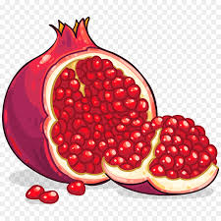
daDim poLLo
daDim poLLo
vittun
Pomegranate
Seeds

Slide 10
daDim PoLLo
tu kaay saartE/saariyo? ( What do you see?)
mii daDim poLLo SaartE/Saariyo ( I see a pomegranate)
daDim poLLlo kollEd/kOT SEtE? ( where is pomegranate?)
daDim poLLo, poLLaan teTTaam (Fruits Plate) sE. (pomegranate is on the fruit plate)
daDim poLLo poLLaan tETtaam KOn thoveyO? ( who put pomegranate on the fruit plate)
Dhadim pollo, poLLaaan teTTaam Bo thoveyo ( Bho put mango on the fruit plate)
Thu kago Dhadim poLLo Saartey? ( Why do you look at pomegranate)
Mii daDim poLLo khaatho kucci saarthE ( I want to eat pomegranate. That is why looking)
Thogo atto bhuukh kerariyo ya? ( Are you hungry now?)
mogo atto bhuukh kerariyo ( I am hungry now)
daDim poLLo piKki sEyaa? ( Is the pomegranate ripe?)
daDim poLLo pikki sEy ( Yes, pomegranate is ripe)
tu onTe Dhadim poLLo khaLLi kadi, sol , vittu heDi Kha ( You take one pomegranate, cut, peel the kernels and eat)
mii onTe daDim poLLo khalli kadi soli vittu heDi khavus ( I will take one pomegranate, cut , peel the kernels and eat)
daDim PoLLo guLLe sEya? ( Is the pomegranate sweet?)
haay daDim poLLo guLLe SE (yes the pomegranate is sweet)
haay ydaDim poLLo guLLe seE( Yes, the pomegranate is sweet)
Asko haDim polloa khaihi/kaitiyo ya? ( Did you eat the full pomegranate?)
haay asKo DaDim pLLl a khathi/kaithiyo ( Yes, I ate the full pomegranate)
Thogo PoAD bhoresya? ( Is your stomach full now?)
Mogo PoAD bhojJo ( My stomach is full)

Slide 11
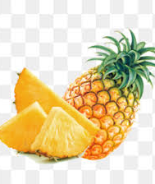
jhaaDu poLLo
JhaaDu poLLo
kiitun
PineApple
slices

Slide 12
ponisu poLLo
ponisu poLLo
suLE
JackFruit
Flesh

Slide 13
koyyaa poLLo Guava

Slide 14
takkaaLi
Tomato

Slide 15
kando
Onion

Slide 16
losan Garlic

Slide 17
allo Ginger

Slide 18
vangi
EggPlant

Slide 19
vittu Seed

Slide 20
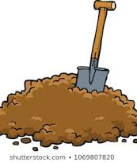
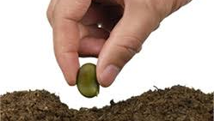
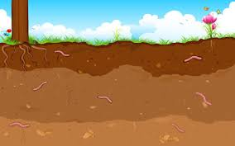
bhoyn bhittar vittu ghali matti thayi jhaytan
Plant seeds in the ground and cover with soil.
Ground – bhoyn
Seed - vittu
Soil – matti
Plant seed – vittu ghaal
Cover - Jjhaay

Slide 21
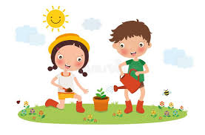
pani soDno Water it
pani sodariyo
(Watering the plant)
surit avdras
(Sun is out)
paTcin huDaras
(Birds are flying)
Bei pani soDaris
(Sister is pouring water)
babu pani soDaras
(Brother is pouring water)

Slide 22
niccu pani soDi siilariyO I take care of the plant by watering everyday
Tu ghale vittu kaay hyiras? ( What happened to the seed you planted)
mii thovE vittum jhaaD avdras ( Plant has sprouted from the seed I planted)
dii paan avdras (Two leaves have sprouted)
nhanno kommo sE (Small branch has sprouted)

Slide 23
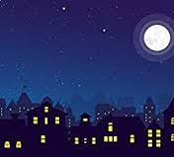
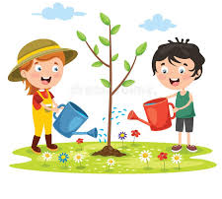
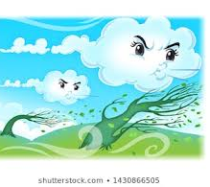
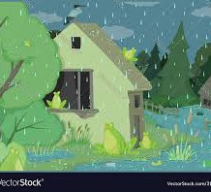
niccu pani soDi jhaad mhoDo hoLLudaras Plant is growing when I water every day
jhaaD mhoDo hoDaraskyaa? (Is the plant growing big?)
haay Jhaad modo hodaras (Yes plant is growing big)
morE sommar unco hoyyo (It is taller than me)
kommo theenE avdriyo ( Three branches have grown)
jhukku paan avdriyo (Lot of leaves have grown)
soLlo hOras. surit avaras. huun hanaras (Morning comes. Sun comes out. Day gets hot and sunny)
raat hOras. Cendaam kin cukko avaras (Night comes. Moon and stars come)
onTe dinnu mobbu avaras ( It is cloudy one day)
onTe dinnu varo hanaras ( It is windy one day)
onTe dinnu poyus poDaras ( It is rainy one day)

Slide 24
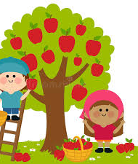
jaad mhoTTo hoDi poLLo lydras Plant has grown big and started bearing fruits
tu jhaaDum kaay saariyO? ( What are YOU looking in the tree?)
mII JhaaDum poLL saariyo( I am checking fruits in the tree)
angun Kailokan sEyaa? ( Are the fruits still unripe?)
haai angun kailo gan sE ( Yes fruits are not ripe yet)
togo kOn uncho tukkilriyo? ( Who is carrying you up?)
mogo avre bo uncho tukkilriyo. (My dad is carrying me up)
togo kako uncho thukkilriyo? (Why are you carried up?)
mii uncho sEthe poLLaan anduno meni ( I want to reach the fruits on the top)
PoLLo atto pikkiraskyaa? ( Are the fruits ripe now?)
haai poLLo atto pikkiyiras ( Yes, the fruits are ripe now)
mi atto poLLo thoDuvaaykyaa? ( Shall I pick the fruits now?)
mii kin dado onTe ladder um hingi uncho sEte poLLaan andi toDuves ( Me and my brother will climb the ladder to reach the fruits on top and pluck)

Slide 25
mii hoDaDE poLLo The fruit I grew
tu hovde poLLo kOno sE? ( How is the fruit you grew?)
mii hovde poLLo ruchi kan sEy ( The fruit I grew is tasty)
mogo jhukku sontOsh kan lagaras ( I feel very happy)

Slide 26
New words practice
poLLo - Fruit
Kaylaan(KailoKesur) – Vegetables
kache/kailo – Raw (Unripe)
tovdo - Skin
sole - Peel
kaad – cut
vitu – Seed
Pikki – Ripe
keLo – Banana
Kaccambaa poLLo – Mango
dadIm poLLo – Pomegranate
JhaaDu poLLo – PineApple
ponisu poLLo – JackFruit
koyyaa poLLo – Guava
takkaaLi – Tomato
kanho – Onion
losan – Garlic
allo – Ginger
vangi - EggPlant
bhoyn – Groundv
Vithu – Seed
mathi – Soil
ghaali/thOvi – Putj
Jhaay – Cover
vittu ghaal – Put seed
matti thayi jhay – Cover soil
pani sOD – Water plant
niccu siiele – Take care dailyj
JhaaD – Plant/Tree
paan – Leaf
Kommo – Branch
Kailo – unripe fruit/unripe vegetable
Pikki – ripe
niccu - daily
soLobhaar – Morning
raat – Night
surit – Sun
cendaam – moon
chukko – Star
huun – Sunny and hot
soLo hOras – Morning comes
raat hOras – Night comes
surit avaras – Sun comes out
varo – wind
povus - rain
guLLe – Sweet
uncho – on top
andi – Reach
toDatE– to pick/pluck
tukkilE – carry
bhuukh – hungry
saatE – to see
thovathE – to put
bhorathey – to get filled
mhoto – big
nhanno - small

Slide 27
New words practice – quiz
poLLokaylaan –
Kacha/kailo –
tovDo -
sole -
khaaD –
vittu –
pikke
keLo –
kaccambaa poLLo –
daDim PoLLo –
JhaaDu poLLo –
ponisu poLLo –
koyyaa poLLo –
takkaaLi –
kando –
losan –
allo –
vangi -
bhoyn –
vittu –
matti –
Ghali/thovi – jJhaai –
Vitthu ghali –
Mathi thai jhaai –
Pani sodi –
NiCchu seeli –
Jhaad –
paan –
kommo –
kailo -
pikki –
niccu -
soLobhaar –
raat –
surit –
Cendaam –
Chukko –
huun –
soLo hOras –
raat hOras –
surit avaras -
varo –
povus -
guLLe –
uncho –
andi –
toDate –
tukkiley –
bhookh –
saate –
thovathe –
bhorathe –
mhodo –
nanno -

Slide 28
Practice
tu thove vittu kaay hoyras? ( What happened to the seed you planted)
mii thove vittum jhaaD avdras ( Plant has sprouted from the seed I planted)
dee paan avdras (Two leaves have sprouted)
nhanno kommo sEy (Small branch has sprouted)

Slide 29
Quiz
( What happened to the seed you planted)
( Plant has sprouted from the seed I planted)
(Two leaves have sprouted)
(Small branch has sprouted)

Slide 30
Practice
jhaaD mhoDo hodaraskyaa? (Is the plant growing big?)
haay jhaaD mhoDo hoDaras (Yes plant is growing big)
mOre sommar Uncho hoyyo (It is taller than me)
kommo thiine avdriyo ( Three branches have grown)
jhukku paan avdriyo (Lot of leaves have grown)
soLo hOras. surith avaras. huun hanaras (Morning comes. Sun comes out. Day gets hot and sunny)
raath hOras. Cendaam kin chukko avaras (Night comes. Moon and stars come)
onTe dinnu mobbu avaras ( It is cloudy one day)
onTe dinnu varo hanaras ( It is windy one day)
onTe dinnu poyus poDaras ( It is rainy one day)

Slide 31
Quiz
(Is the plant growing big?)
(Yes plant is growing big)
(It is taller than me)
( Three branches have grown)
(Lot of leaves have grown)
(Morning comes. Sun comes out. Day gets hot and sunny)
(Night comes. Moon and stars come)
( It is cloudy one day)
( It is windy one day)
( It is rainy one day)

Slide 32
Practice
tu jhaDdum kaay saariyO? ( What are you looking in the tree?)
mii JhaaDum poLLo saariyo( I am checking fruits in the tree)
angun kaylogan sEyA? ( Are the fruits still unripe?)
Haay angun kaylogan sey ( Yes fruits are not ripe yet)
togo kOn uncho tukkilriyO? ( Who is carrying you up?)
mogo avrE bo uncho thukkilriyo. (My dad is carrying me up)
togo kago uncho thukkilriyo? (Why are you carried up?)
mii uncho sEthE poLLo anduno meni ( I want to reach the fruits on the top)
poLLo atto pikkiraskyae? ( Are the fruits ripe now?)
haay poLLo atto pikkiyiras ( Yes, the fruits are ripe now)
mi atto poLLo toDuvaaykyaa? ( Shall I pick the fruits now?)
mii kin dado onTe ladder um hingi uncho sEtte poLLo andi toDuves ( Me and my brother will climb the ladder to reach the fruits on top and pluck)

Slide 33
Quiz
( What are you seeing in the tree?)
( I am checking fruits in the tree)
( Are the fruits still unripe?)
( Yes fruits are not ripe yet)
( Who is carrying you up?)
(My dad is carrying me up)
(Why are you carried up?)
( I want to reach the fruits on the top)
( Are the fruits ripe now?)
( Yes, the fruits are ripe now)
( Shall I pick the fruits now?)
( Me and my brother will climb the ladder to reach the fruits on top and pluck)

